Slide 1

D i f ferent ia l expression analysis
RNA-SEQ WITH BIOCONDUCTOR IN R
Dr Umar Ahmad
Senior Genomic Scientist

Slide 2

RNA-SEQ WITH BIOCONDUCTOR IN R

Slide 3
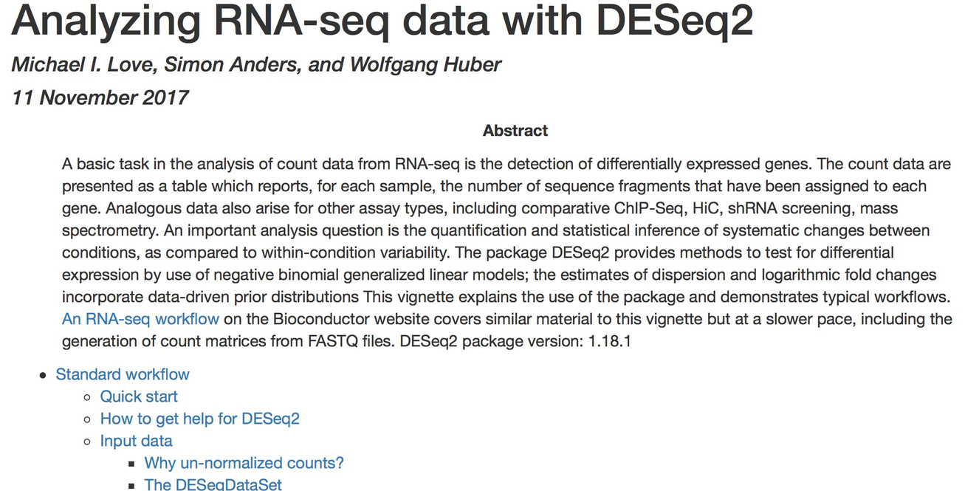
Differential expression analysis: DESeq2 vignette
vignette(DESeq2)
RNA-SEQ WITH BIOCONDUCTOR IN R

Slide 4

RNA-SEQ WITH BIOCONDUCTOR IN R

Slide 5
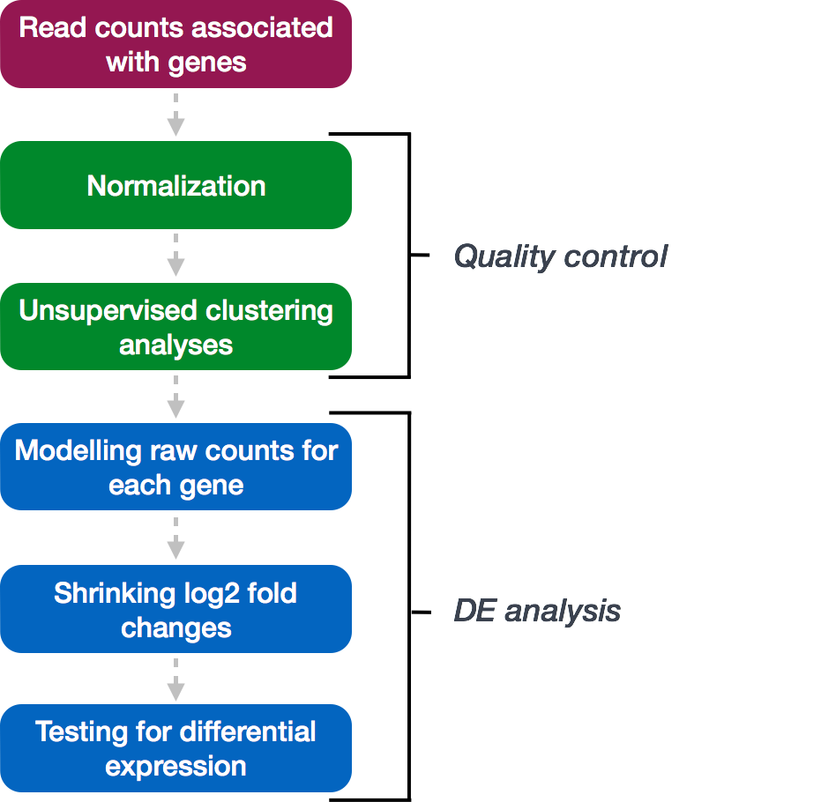
RNA-SEQ WITH BIOCONDUCTOR IN R

Slide 6
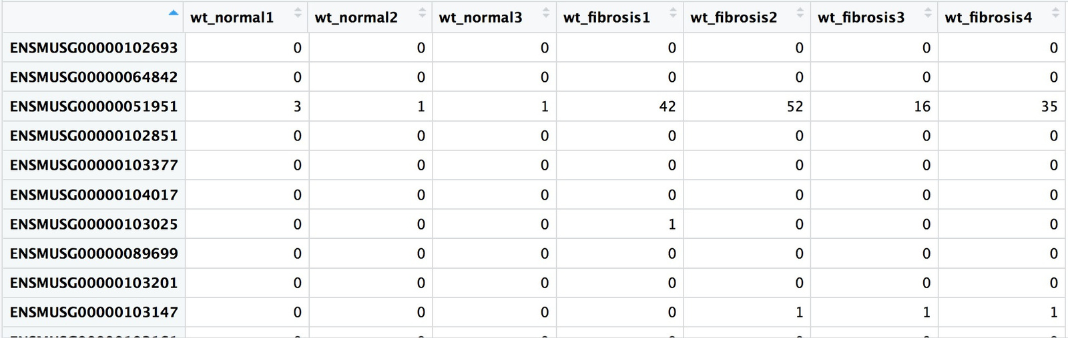
Bringing in data for DESeq2
# Read in raw counts wt_rawcounts <- read.csv("fibrosis_wt_rawcounts.csv") View(wt_rawcounts)
RNA-SEQ WITH BIOCONDUCTOR IN R

Slide 7
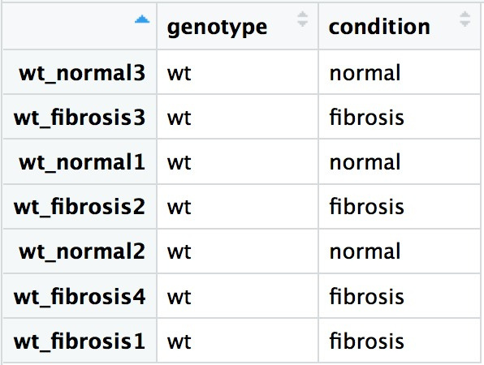
Bringing in data for DESeq2: metadata
# Read in metadata wt_metadata <- read.csv("fibrosis_wt_metadata_unordered.csv") View(wt_metadata)
RNA-SEQ WITH BIOCONDUCTOR IN R

Slide 8

Let's practice!
RNA-SEQ WITH BIOCONDUCTOR IN R

Slide 9

Organizing the data for DESeq2
RNA-SEQ WITH BIOCONDUCTOR IN R
Dr Umar Ahmad
Senior Genomic Scientist

Slide 10
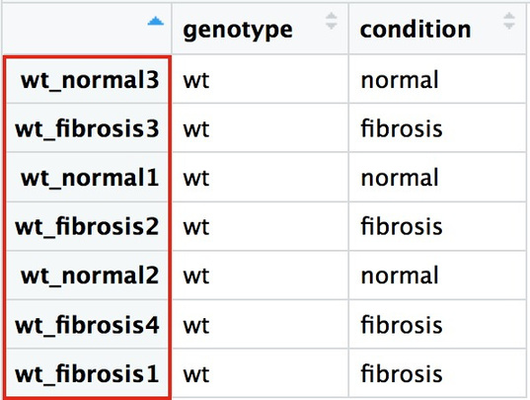
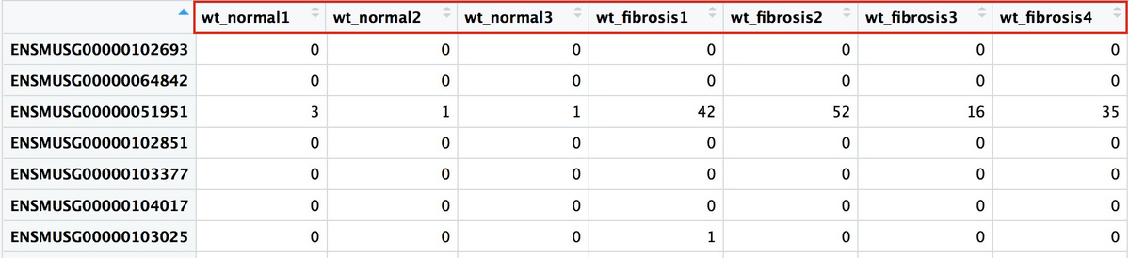
Bringing in data for DESeq2: sample order
Metadata
Raw counts
RNA-SEQ WITH BIOCONDUCTOR IN R

Slide 11

Bringing in data for DESeq2: sample order
rownames(wt_metadata)
[1] "wt_normal3" "smoc2_fibrosis2" "wt_fibrosis3" "smoc2_fibrosis3" "smoc2_normal3"
"wt_normal1"
[7] "smoc2_normal4" "wt_fibrosis2" "wt_normal2" "smoc2_normal1" "smoc2_fibrosis1" "smoc2_fibrosis4"
[13] "wt_fibrosis4" "wt_fibrosis1"
colnames(wt_rawcounts)
[1] "wt_normal1" "wt_normal2" "wt_normal3" "wt_fibrosis1"
"wt_fibrosis2"
"wt_fibrosis3"
[7] "wt_fibrosis4" "smoc2_normal1" "smoc2_normal3" "smoc2_normal4"
"smoc2_fibrosis1" "smoc2_fibrosis2"
[13] "smoc2_fibrosis3" "smoc2_fibrosis4"
RNA-SEQ WITH BIOCONDUCTOR IN R

Slide 12

Bringing in data for DESeq2: sample order
all(rownames(wt_metadata) == colnames(wt_rawcounts))
FALSE
RNA-SEQ WITH BIOCONDUCTOR IN R

Slide 13

Matching order between vectors
Using the
match()
function:
match(vector1, vector2)
vector1: vector of values with the desired order
vector2: vector of values to reorder
output: the indices for how to rearrange vector2 to be in the same order as vector1
match(colnames(wt_rawcounts), rownames(wt_metadata)
6
9
1
14 8
3
13 10 5
7
11 2
4
12
RNA-SEQ WITH BIOCONDUCTOR IN R

Slide 14
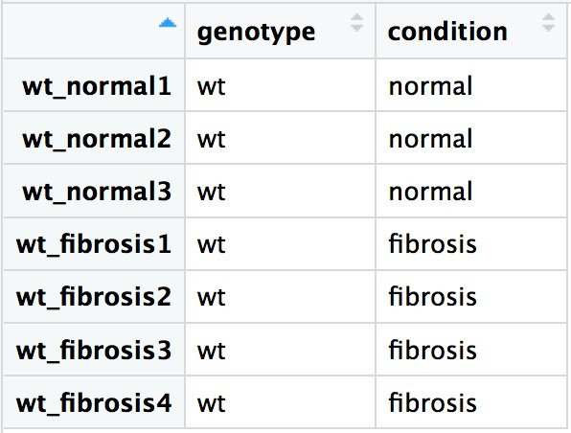
Reordering using
match()
output:
idx <- match(colnames(wt_rawcounts), rownames(wt_metadata)) reordered_wt_metadata <- wt_metadata[idx, ] View(reordered_wt_metadata)
RNA-SEQ WITH BIOCONDUCTOR IN R

Slide 15
all(rownames(reordered_wt_metadata) == colnames(wt_rawcounts))
TRUE
RNA-SEQ WITH BIOCONDUCTOR IN R

Slide 16
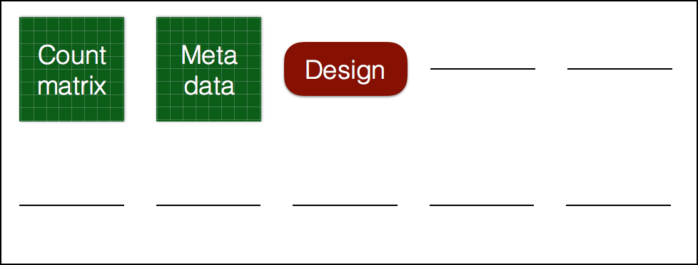
Creating the DESeq2 object
# Create DESeq object dds_wt <- DESeqDataSetFromMatrix(countData = wt_rawcounts,
colData = reordered_wt_metadata, design = ~ condition)
RNA-SEQ WITH BIOCONDUCTOR IN R

Slide 17
Let's practice!
RNA-SEQ WITH BIOCONDUCTOR IN R

Slide 18

Count normalization
RNA-SEQ WITH BIOCONDUCTOR IN R
Dr Umar Ahmad
Senior Genomic Scientist

Slide 19
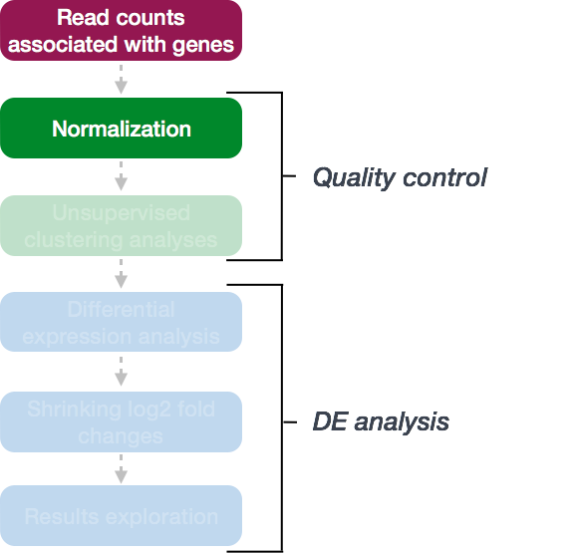
RNA-SEQ WITH BIOCONDUCTOR IN R

Slide 20
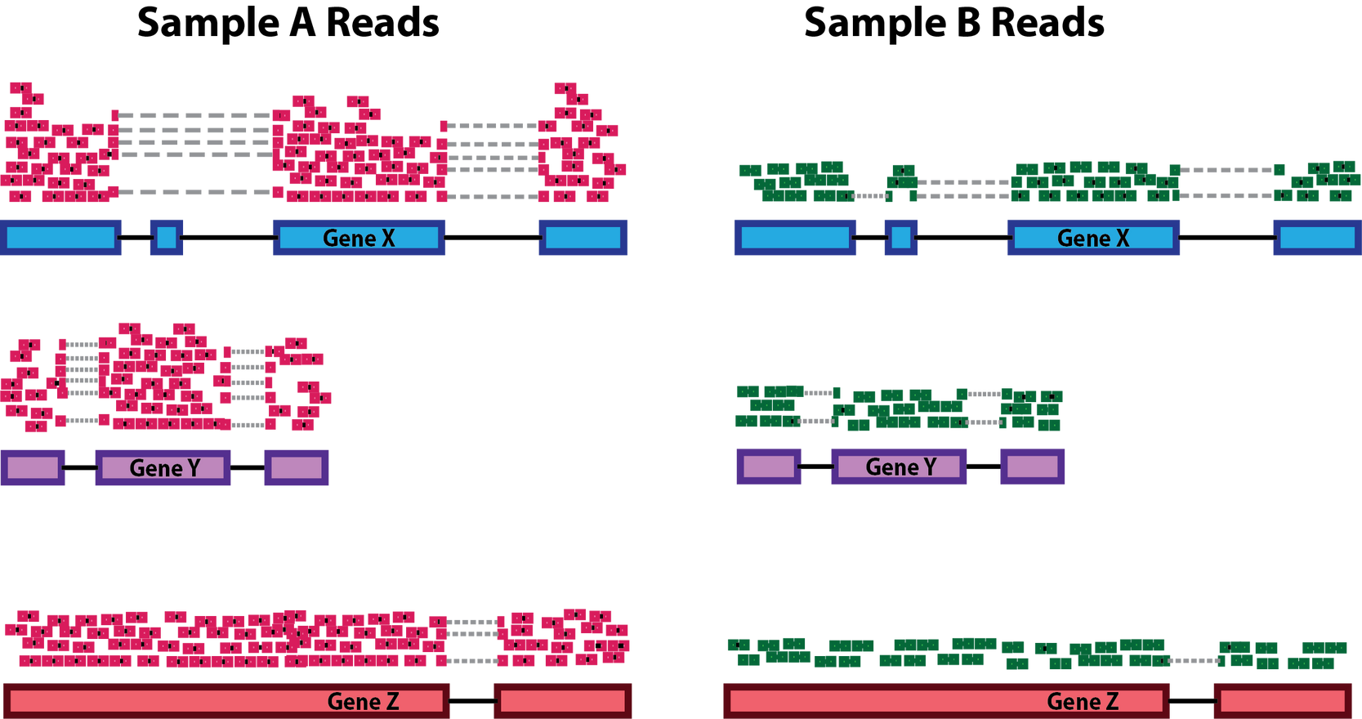
Count normalization
RNA-SEQ WITH BIOCONDUCTOR IN R

Slide 21
Library depth normalization
RNA-SEQ WITH BIOCONDUCTOR IN R

Slide 22
RNA-SEQ WITH BIOCONDUCTOR IN R

Slide 23
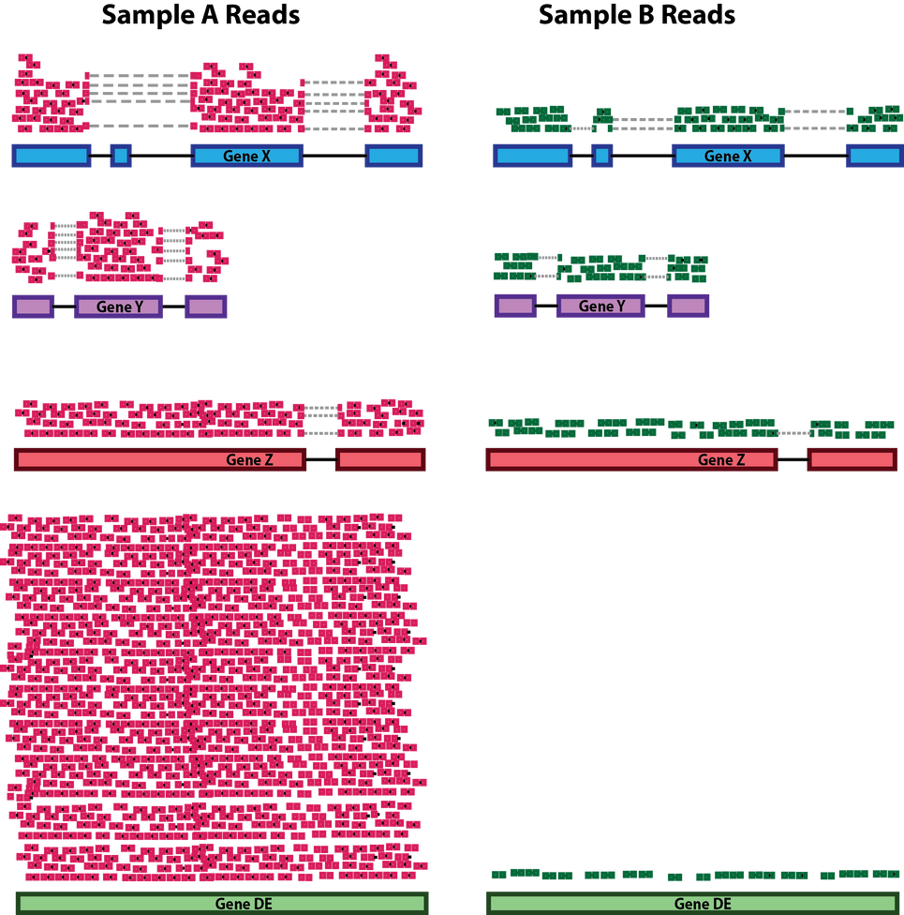
Library composition effect
RNA-SEQ WITH BIOCONDUCTOR IN R

Slide 24
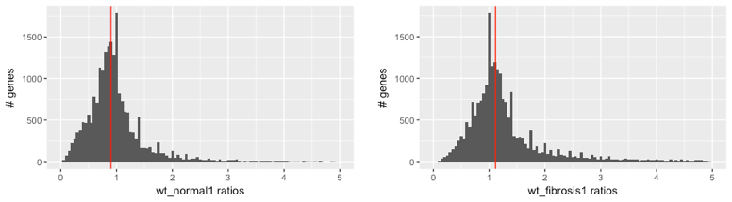
DESeq2 normalization
RNA-SEQ WITH BIOCONDUCTOR IN R

Slide 25
Normalized counts: calculation
dds_wt <- estimateSizeFactors(dds_wt) sizeFactors(dds_wt)
RNA-SEQ WITH BIOCONDUCTOR IN R

Slide 26
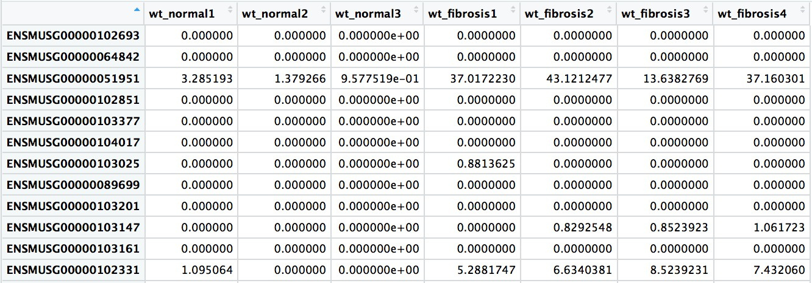
Normalized counts: extraction
normalized_wt_counts <- counts(dds_wt, normalized=TRUE) View(normalized_wt_counts)
RNA-SEQ WITH BIOCONDUCTOR IN R

Slide 27
Let's practice!
RNA-SEQ WITH BIOCONDUCTOR IN R

Slide 28

Unsupervised clustering analyses
RNA-SEQ WITH BIOCONDUCTOR IN R

Slide 29
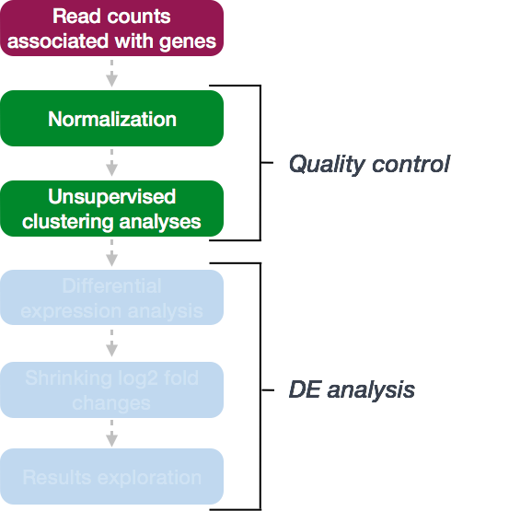
RNA-SEQ WITH BIOCONDUCTOR IN R

Slide 30

Unsupervised clustering analyses: log transformation
vsd_wt <- vst(dds_wt, blind=TRUE)
RNA-SEQ WITH BIOCONDUCTOR IN R

Slide 31
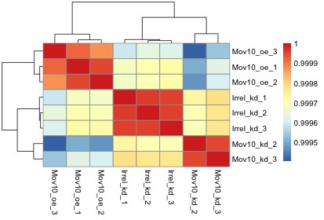
RNA-SEQ WITH BIOCONDUCTOR IN R

Slide 32
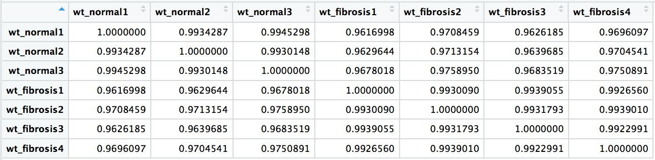
Hierarchical clustering with correlation heatmaps
# Extract the vst matrix from the object vsd_mat_wt <- assay(vsd_wt) # Compute pairwise correlation values vsd_cor_wt <- cor(vsd_mat_wt) View(vsd_cor_wt)
RNA-SEQ WITH BIOCONDUCTOR IN R

Slide 33

Hierarchical clustering with correlation heatmaps
# Load pheatmap libraries library(pheatmap)
# Plot heatmap pheatmap(vsd_cor_wt, annotation = select(wt_metadata, condition))
RNA-SEQ WITH BIOCONDUCTOR IN R

Slide 34
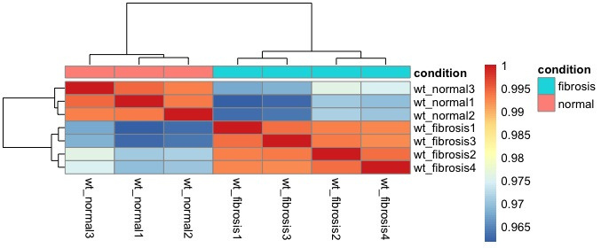
Hierarchical clustering with correlation heatmaps
RNA-SEQ WITH BIOCONDUCTOR IN R

Slide 35
Let's practice!
RNA-SEQ WITH BIOCONDUCTOR IN R

Slide 36

Principal component analysis
RNA-SEQ WITH BIOCONDUCTOR IN R
Dr Umar Ahmad
Senior Genomic Scientist

Slide 37
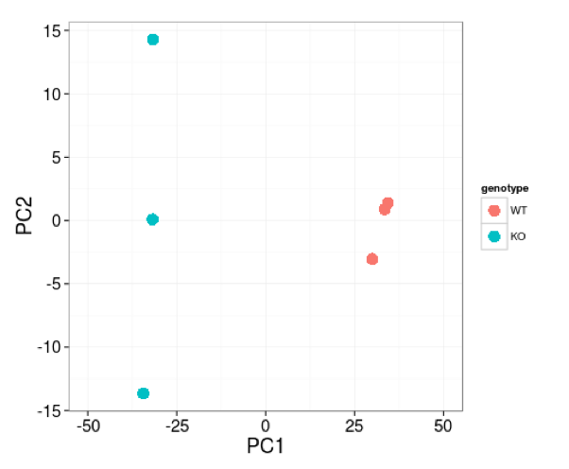
RNA-SEQ WITH BIOCONDUCTOR IN R

Slide 38
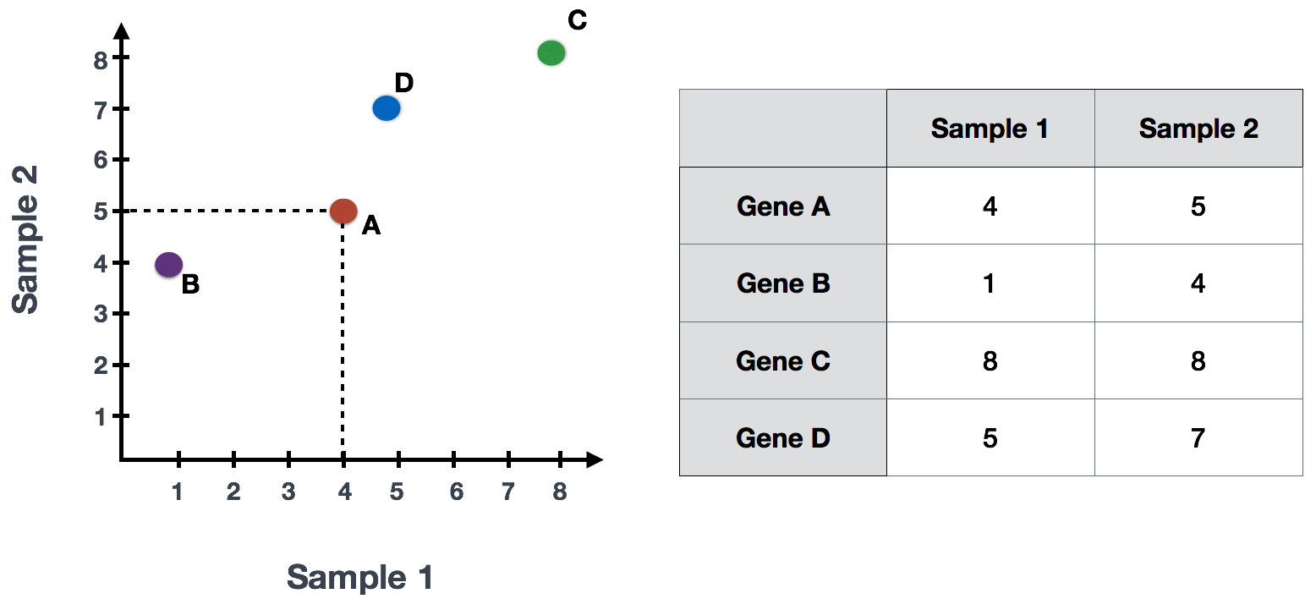
Principal component analysis (PCA): Theory
RNA-SEQ WITH BIOCONDUCTOR IN R

Slide 39
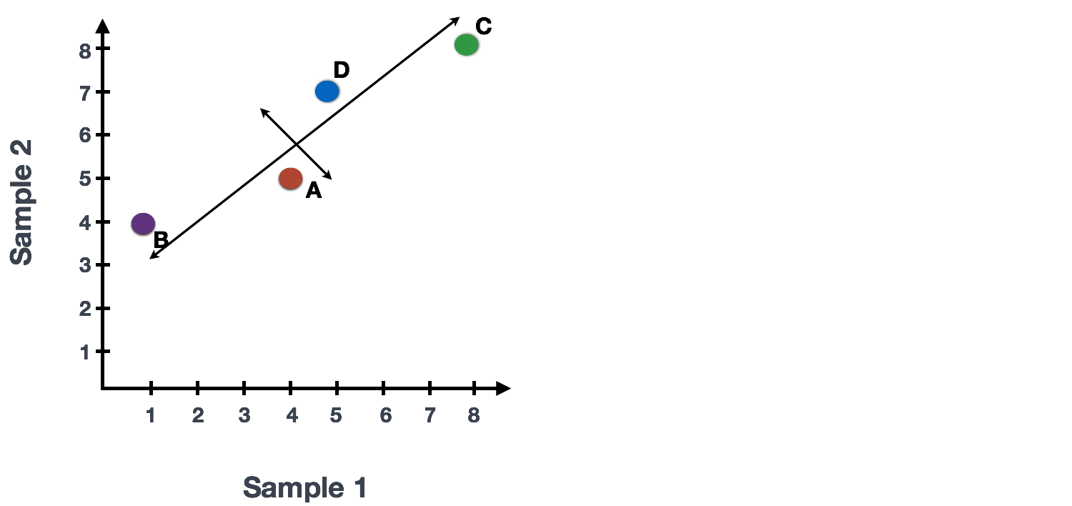
Principal component analysis (PCA): Theory
RNA-SEQ WITH BIOCONDUCTOR IN R

Slide 40
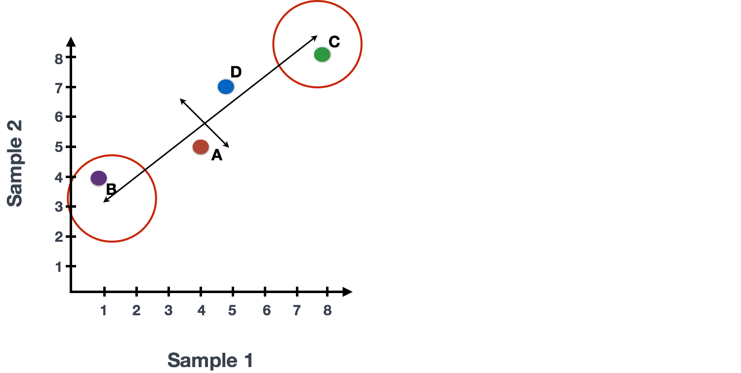
Principal component analysis (PCA): Theory
RNA-SEQ WITH BIOCONDUCTOR IN R

Slide 41
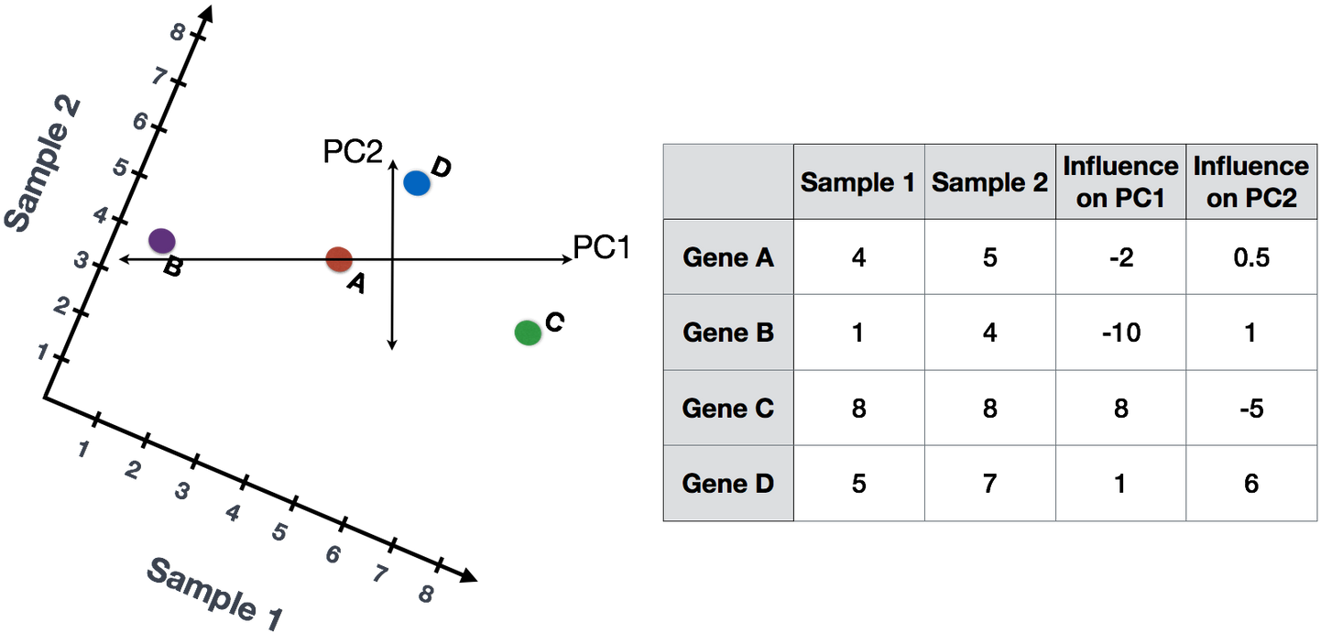
Principal component analysis (PCA): Theory
RNA-SEQ WITH BIOCONDUCTOR IN R

Slide 42
Principal component analysis (PCA): Theory
Sample1 PC1 score = (4 * -2) + (1 * -10) + (8 * 8) + (5 * 1) = 51 Sample1 PC2 score = (4 * 0.5) + (1 * 1) + (8 * -5) + (5 * 6) = -7
Sample2 PC1 score = (5 * -2) + (4 * -10) + (8 * 8) + (7 * 1) = 21 Sample2 PC2 score = (5 * 0.5) + (4 * 1) + (8 * -5) + (7 * 6) = 8.5
RNA-SEQ WITH BIOCONDUCTOR IN R

Slide 43
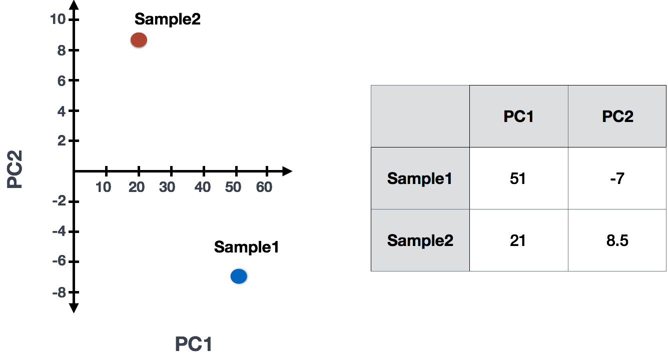
RNA-SEQ WITH BIOCONDUCTOR IN R

Slide 44
RNA-SEQ WITH BIOCONDUCTOR IN R

Slide 45
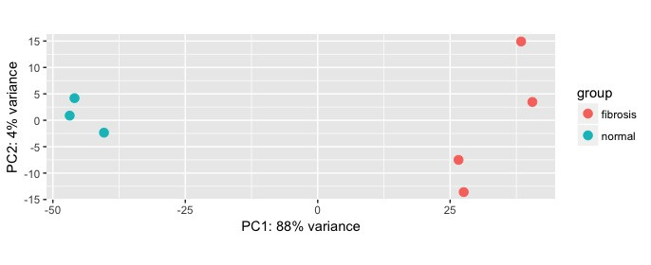
Principal component analysis (PCA): Theory
# Plot PCA plotPCA(vsd_wt, intgroup="condition")
RNA-SEQ WITH BIOCONDUCTOR IN R

Slide 46

Let's practice!
RNA-SEQ WITH BIOCONDUCTOR IN R

